Slide 1
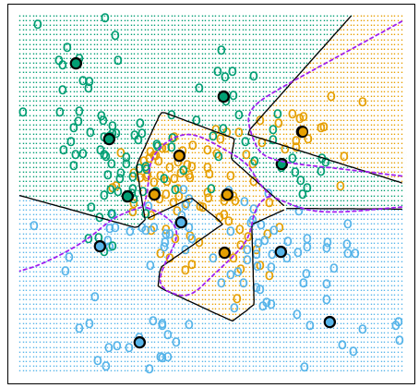
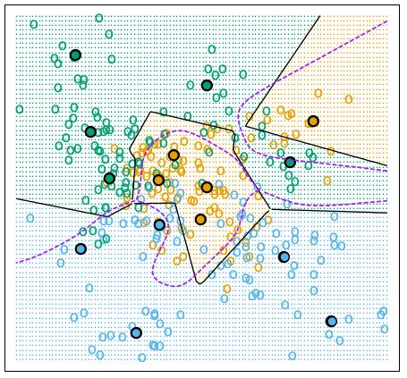
Example: Learning Vector Quantization
(a) K-means, 5 Prototypes per Class
(b) LQA, 5 Prototypes per Class
ELS-II Figure 13.1. Simulated example with three classes and five prototypes per class. The data in each class are generated from a mixture of Gaussians. In the left panel, the prototypes were found by applying the K-means clustering algorithm separately in each class. In the right panel, the LVQ algorithm (starting from the K-means solution) moves the prototypes away from the decision boundary. The broken purple curve in the background is the Bayes decision boundary.

